Slide 1
ECAP
Class of 2026
IRHS Counselors
November/December 2022

Slide 2

Agenda
Portrait of a Graduate
Who is your Counselor?
Respect & Resiliency
ECAP & Future Planning
Academic Success & Final Exams
Getting Involved
Social Media
Questions / Exit Ticket

Slide 3
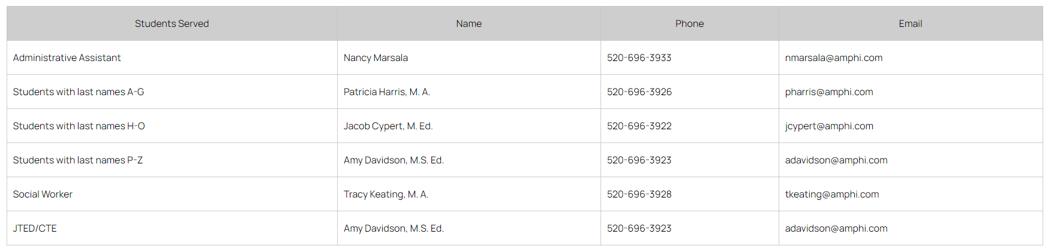
Who is Your Counselor?

Slide 4


Respect & Resiliency
Respect:
A. to consider worthy of high regard
B. to refrain from interfering with
Resiliency:
A. the ability to recover from or adjust easily
to adversity or change
POG: Caring, Citizenship, Communication

Slide 5
Ways to show Respect
Speak politely
Be friendly and positive
Listen to what others have to say without interrupting
Do not spread gossip or rumors
?
?
?

Slide 6
Ways to develop Resiliency
Believe in yourself
Establish goals for yourself
Be optimistic
Embrace change
Take care of yourself
Develop problem-solving skills
?
?
?

Slide 7


ECAP:
Education & Career Action Plan
Your personal plan for what you are going to do after you graduate from high school.
Major Clarity - take career assessments, find out about careers, explore the education needed for different careers and create a plan to meet your goals.
  Use this information to help you choose your courses throughout high school to be better prepared for what you want to do.
POG: Academic Content, Creative Thinking, Critical Thinking, Problem Solving

Slide 8



Planning for life after high school:
The three Es
Enroll:
  4-year University (UA, NAU, ASU, GCU, out of state)
  2-year Community College (Pima, Coconino)
  Technical/Vocational (Universal Technical Institute, Carrington College)
Enlist:
  Military – choose the branch that is best for you.
Employ:
  Straight to work
  Applies to everyone eventually
POG: All points factor into this decision.

Slide 9
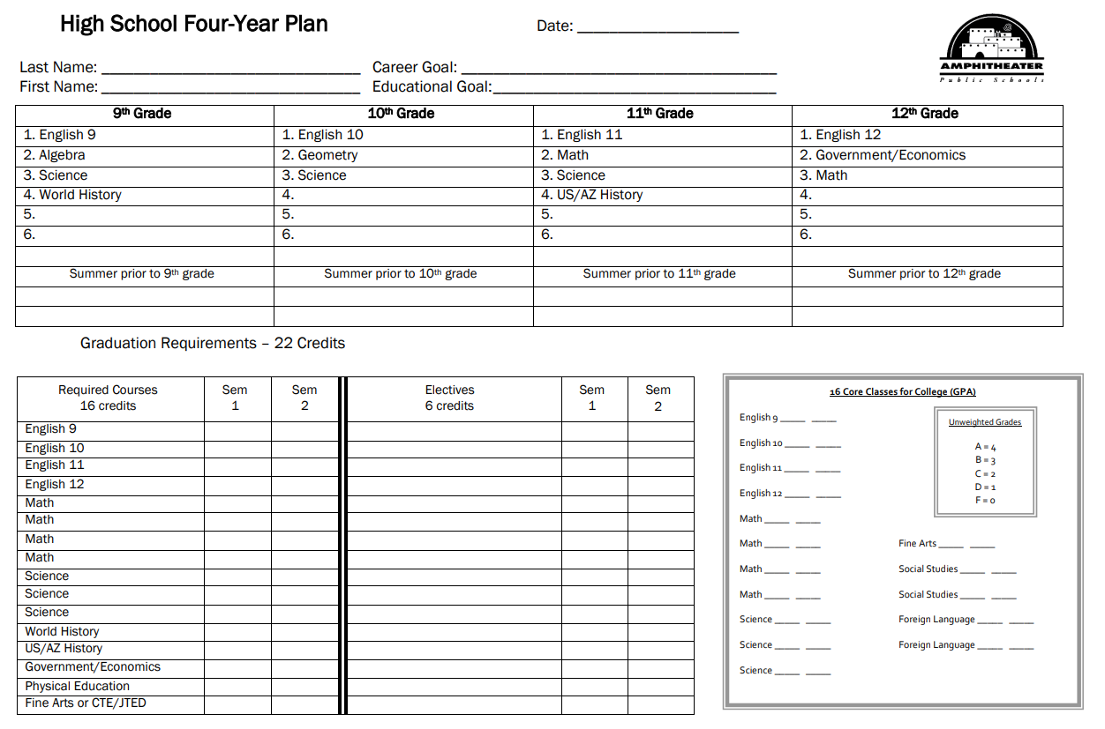
Four Year Plan

Slide 10



Academic Success & Finals
Academic Success:
  Go to class on time and be ready to work; do your homework and turn it in!
    Create a specific time and place to do your homework.
  Talk to your teachers if you are struggling to understand something.
Final Exams:
  Start studying early. Create a study schedule to help you stay on track.
  Take advantage of office hours, travel days for Advisory and after school tutoring.
  Study with a partner or in groups. You can quiz each other and help each other out.
  Create flash cards, rewrite your notes, review your notes and textbooks , redo problems.
  Make sure to get enough sleep and eat well. Drink plenty of water.
  ?
POG: Academic Content

Slide 11



Getting Involved
Get involved in art, drama, sports, music, a club on campus or connect with organizations in the community that offer service opportunities to teens. These are great ways to find out more about your interest in these areas and allow you to become part of a community within the IRHS community.
Start gathering information now about what colleges, the military and employers are looking for in prospective candidates.
  Talk to representatives from colleges and the military that visit IRHS. Representatives are usually outside the main office when they are on campus. Check the daily announcements and the calendar on the Counseling website for who is coming to campus and when.
POG: Citizenship, Caring, Creative Thinking, Collaboration

Slide 12




Social Media Etiquette
Start tuning up your social media accounts!
31% of college admissions representatives say they do a social media check on applicants and many employers do as well.
So, what does your digital footprint say about you?
  Proper e-mail address?
  Pictures?
  Posts?
Before you post, THINK:
  Is it:
    T – True
    H – Helpful
    I – Illegal
    N – Necessary
    K – Kind
If it’s on the internet, it isn’t private anymore!
POG: Communication, Caring, Citizenship

Slide 13

Schoology
Counselors’ course in Schoology:
  Counseling: Class of 2026
  Access code: PRRP-3R6Q-92BTC
We will use this to share information about specific topics like pre-registration, scholarships, college and military visits.
Assignments such as exit tickets, sign ups for events, etc. will be posted here.
POG: Communication, Collaboration, Academic Content

Slide 14

Wrapping Up
The Exit Ticket can be found in Schoology under Counseling: Class of 2026.
Questions?

